Slide 1

Soil Classification using Deep Learning
Dipto Sen – I026
Dhup Mehta – I025
Dhrish Shah – I024

Slide 2
Table of Contents
Analysis of Different research papers
A study on Deep Learning based Soil Classification
Comparison of Machine Learning Algorithms for Soil Type Classification
Machine Learning Based Soil - Type Classification
Performance of SVM Classifier for Image based Soil Classification
Soil Classification amp Characterization Using Image Processing
Project Overview
Coding Explanation
Conclusion

Slide 3
Analysis of Different research papers

Slide 4
A study on Deep Learning based Soil Classification
Authors: Prabhavathi V and Kuppusamy P, VIT-AP University.
Focus: Utilizing deep learning for soil classification to improve crop selection and yield.
Key Points: Comparison of deep learning models, proposal of a novel model, emphasis on feature and dataset selection.
Conclusion: Deep learning significantly enhances soil classification accuracy, beneficial for sustainable agriculture.

Slide 5
Comparison of Machine Learning Algorithms for Soil Type Classification
Authors: Pramudyana Agus Harlianto, Teguh Bharata Adji, Noor Akhmad Setiawan, Universitas Gadjah Mada.
Focus: Comparative study of SVM, Neural Network, Decision Tree, Naïve Bayesian for soil classification.
Key Points: SVM with a linear kernel function showed the highest accuracy (82.35%).
Conclusion: SVM outperforms in soil type classification, important for agriculture and environmental science.

Slide 6
Machine Learning Based Soil - Type Classification
Authors: Enchalew Enawugaw, Yirga Yayeh.
Focus: Using VGG16, VGG19 for feature extraction, and SVM for classification of soil types.
Key Points: High accuracy with VGG19 and SVM, 2400 images from six sites were used.
Conclusion: Deep learning models like VGG19 significantly improve soil classification accuracy.

Slide 7
Performance of SVM Classifier for Image based Soil Classification
Authors: Srunitha.k, Dr. S. Padmavathi, Amrita Vishwa Vidyapeetham.
Focus: SVM classifiers for soil type classification through image processing.
Key Points: High accuracy rate of 95% for non-sandy soils, using image preprocessing and feature extraction.
Conclusion: Machine learning, particularly SVM, enhances soil classification accuracy for agricultural and environmental applications.

Slide 8
Soil Classification amp Characterization Using Image Processing
Authors: Hement Kumar Sharma, Shiv Kumar, Mewar University.
Focus: SVM and image processing for soil classification and characterization.
Key Points: Development of a tool for farmers to identify soil types and suitable crops.
Conclusion: Leveraging SVM and image processing can improve agricultural productivity and decision-making.

Slide 9
Project Overview

Slide 10
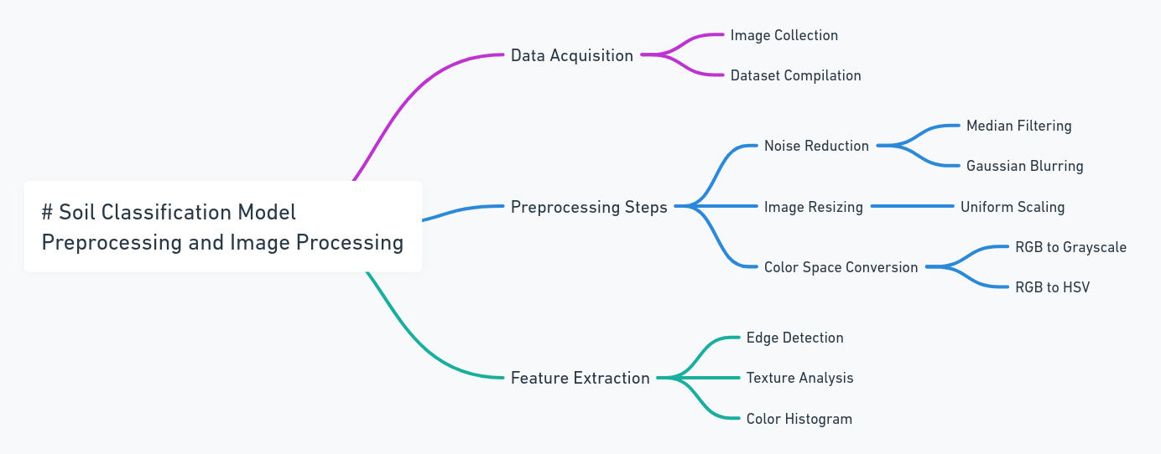

Slide 11
Code Explanation

Slide 12
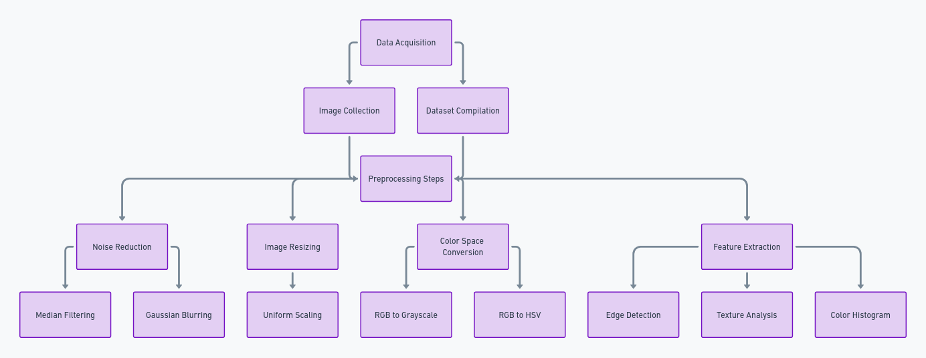

Slide 13
Conclusion

Slide 14
Potential for Overfitting: There is an absence of cross-validation or split-test methodology in the code, which could lead to overfitting. Ensuring the model generalizes well to unseen data is crucial for its applicability in real-world scenarios.
Limited Model Evaluation Metrics: The code lacks the implementation of comprehensive model evaluation metrics such as confusion matrices or classification reports. This limitation prevents a thorough understanding of the model's performance across different soil types, especially in terms of precision, recall, and F1 scores.
Potential Lack of Advanced Feature Extraction Techniques: There is a reliance on basic image processing methods without leveraging more advanced feature extraction techniques. Incorporating techniques like deep learning-based feature extraction could significantly enhance the model's ability to distinguish between complex soil characteristics.

Slide 15
Thank You

